Slide 1

Linear Algebra Project
Project Statement: ‘Finding Steady State of a Network flow. Page Rank to illustrate the Search Engine Results and asserting the fact that Steady state is one of the Eigenvectors of the Matrix.’

Slide 2
Group Members
Nihal Aggarwal : AU1940217
Kavan Desai : AU1940126
Anshul Mehta : AU1940275
Harsh Patel : AU1940114

Slide 3
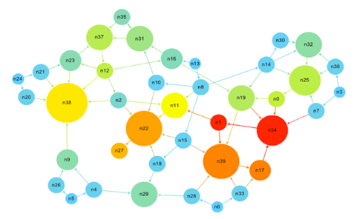
Network and Network Flow
A network is a directed graph that forms a system of nodes and edges that connect them to each other.
A network has multiple connotations across Graph Theory, Linear Algebra, Electric flow, Communication.
Network flow is essentially a graph theory problem where it defines the capacity of each edge in a connected network to transit data
Infographic of Network

Slide 4
What is Steady State in Network Flow?
The state of a system in which the flow of network does not affect the population of nodes.
The stabilized flow of the network results in such a flow that the relative population at the nodes are plateaued according to the potential.
Which implies that the number of visitors / data at the nodes are unchanged irrespective of the flow after a certain number of iterations.

Slide 5

Motivation
One of the most prominent motivation was to understand the approach behind the famous PageRank algorithm that is used by Google in order to Rank pages.
The primary motivation to discover some subtle things about how concepts of linear algebra are used in order to rank the web pages.
Infographic on Website Ranking using Google PageRank Algorithm

Slide 6
Overview
We have defined our primary subject matter as steady state analysis of a network flow.
Steady state analysis means repetitive analysis of a flow in network till it reaches the steady state.
As in PageRank we entertain random clicks/visits to a particular link/node of network or with the real time data sets we can get "more important page" as more scored PageRank and less important page as less scored PageRank.
Whereas, in network flow we have some predefined flow, after over and over iterations we come across a steady state which is steady state of a network flow.
In steady state the value of network flow to the node signifies its influence in the network which can be associated to the PageRank as a rank in the network.

Slide 7
Assumptions and Limitations
The main assumption we use is that since we use Jacobi Algorithm to find the eigenvectors and eigen-values we work with Symmetric Matrices only.
The test cases are preferably in range of 2 x 2 to 5 x 5 matrices as we use matrix multiplication algorithm in O(n^3) time complexity which uses 3 For loops.
The sum of elements of each column of input matrix must be Unity. Each element input must be non negative.

Slide 8
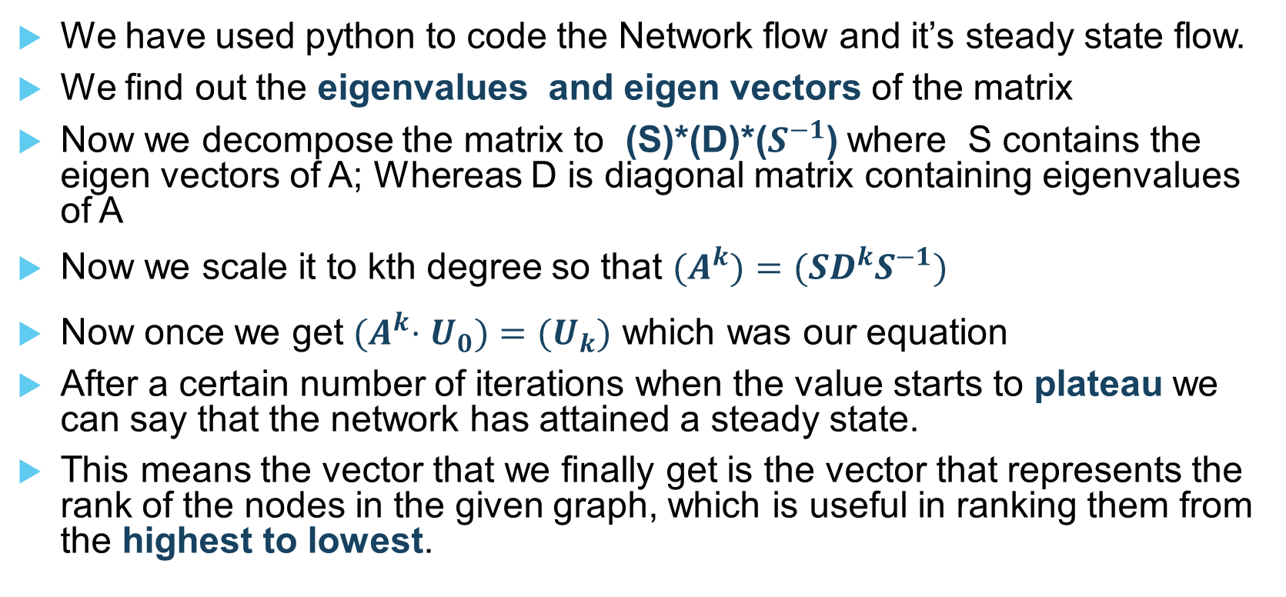
Approach for calculation of Steady state
We have used python to code the Network flow and it’s steady state flow.
We find out the eigenvalues and eigen vectors of the matrix
Now we decompose the matrix to (S)*(D)*($S^{−1}$) where S contains the eigen vectors of A; Whereas D is diagonal matrix containing eigenvalues of A
Now we scale it to kth degree so that ${(A}^{k})=(SD^{k}S^{−1})$
Now once we get ${(A}^{k}⋅U_{0})={(U}_{k})$ which was our equation
After a certain number of iterations when the value starts to plateau we can say that the network has attained a steady state.
This means the vector that we finally get is the vector that represents the rank of the nodes in the given graph, which is useful in ranking them from the highest to lowest.

Slide 9
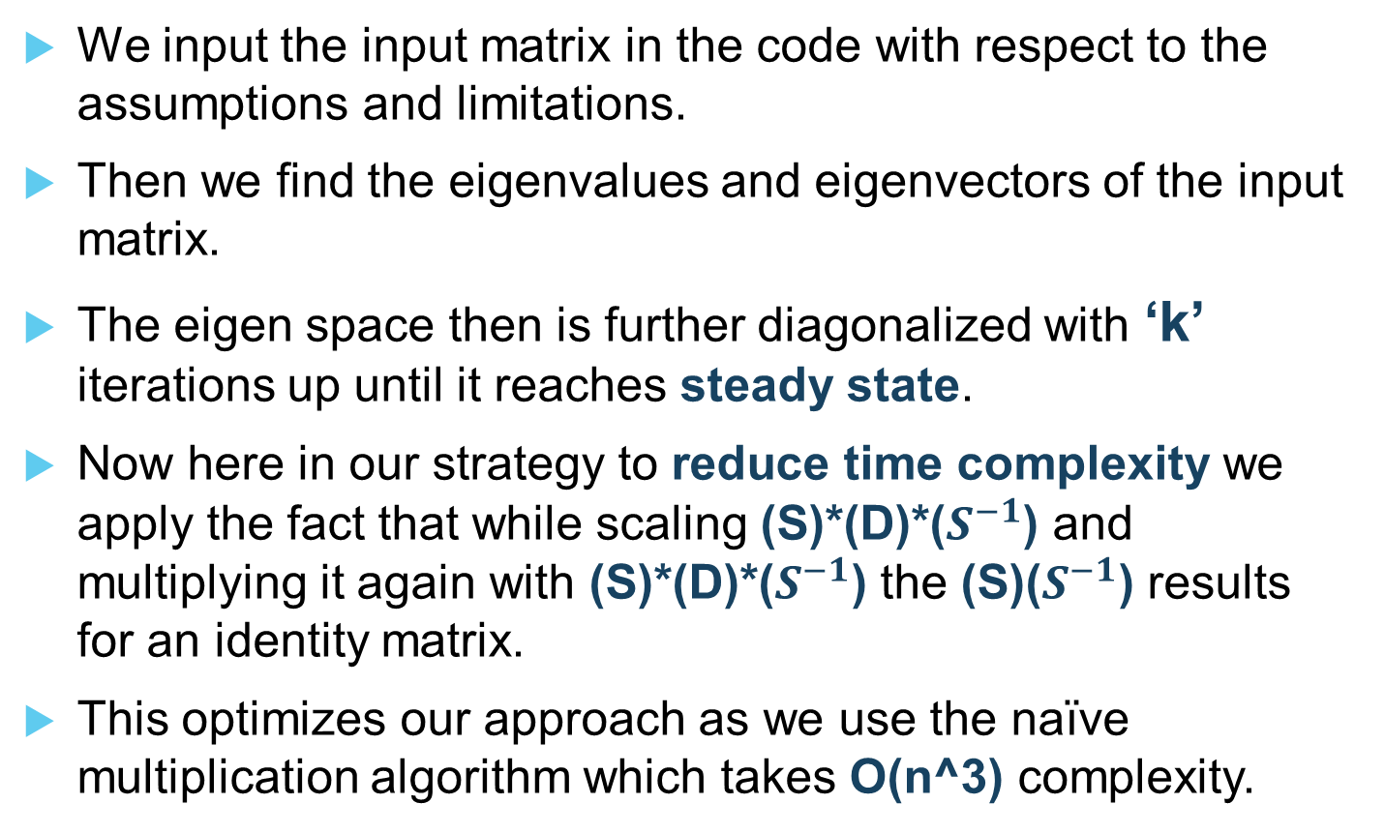
How our code works?
We input the input matrix in the code with respect to the assumptions and limitations.
Then we find the eigenvalues and eigenvectors of the input matrix.
The eigen space then is further diagonalized with ‘k’ iterations up until it reaches steady state.
Now here in our strategy to reduce time complexity we apply the fact that while scaling (S)*(D)*($S^{−1}$) and multiplying it again with (S)*(D)*($S^{−1}$) the (S)($S^{−1}$) results for an identity matrix.
This optimizes our approach as we use the naïve multiplication algorithm which takes O(n^3) complexity.

Slide 10
LA Concepts used for Project
In order to find Eigen values and Eigen vectors we use Jacobi algorithm.
Then we decompose the matrix in terms of its diagonal matrix and eigenvectors.
For the above , we mainly define two functions diagonalization to find the product of eigenvectors matrix, Diagonal matrix and inverse of eigenvectors matrix) and Inverse function to find inverse of eigen vectors matrix.
In Inverse function, we find the inverse of matrix using elementary Row Operations.

Slide 11

Why this approach works?
This approach works because the probability of number of visitors/ data going from one node to another depends upon the previous iteration.
The flow also depends upon a node's connection with other important nodes
This approach works because of the. In a matrix, the probability is are Eigen Centrality Concept designated to nodes. There will be a dominant Eigen Value for which the flow attains a Steady State
We capitalize on this fact that rank of a node only depends on the previous rank. So we find the eigen values and eigenvectors to exponentiation in order to iterate.

Slide 12
Inferences from the Code
The symmetric matrices do give a steady state where the vectors that represents the Steady State is (1, 1, 1, ….).
The non- symmetric matrices do give out the percentage of population/ data that is present at the saturation/ steady state of the flow.
The steady state also speaks about page rank in which the value of each node which is a webpage shows what numbers of visitors are going to stay on a given node and what number are going to transit.
This helps in deciding the relevancy of the pages.

Slide 13
Closing Remarks for our Project
The Steady State of a network is indeed an (proportional) eigen vector of the input Matrix
The Page Rank Algorithm and Power Iteration Algorithm give out similar results as our code because of Eigen Centrality.
Repetitive analysis does actually give out the steady state of the network flow and so does it give out convincing results for algorithms like PageRank.

Slide 14


